Slide 1
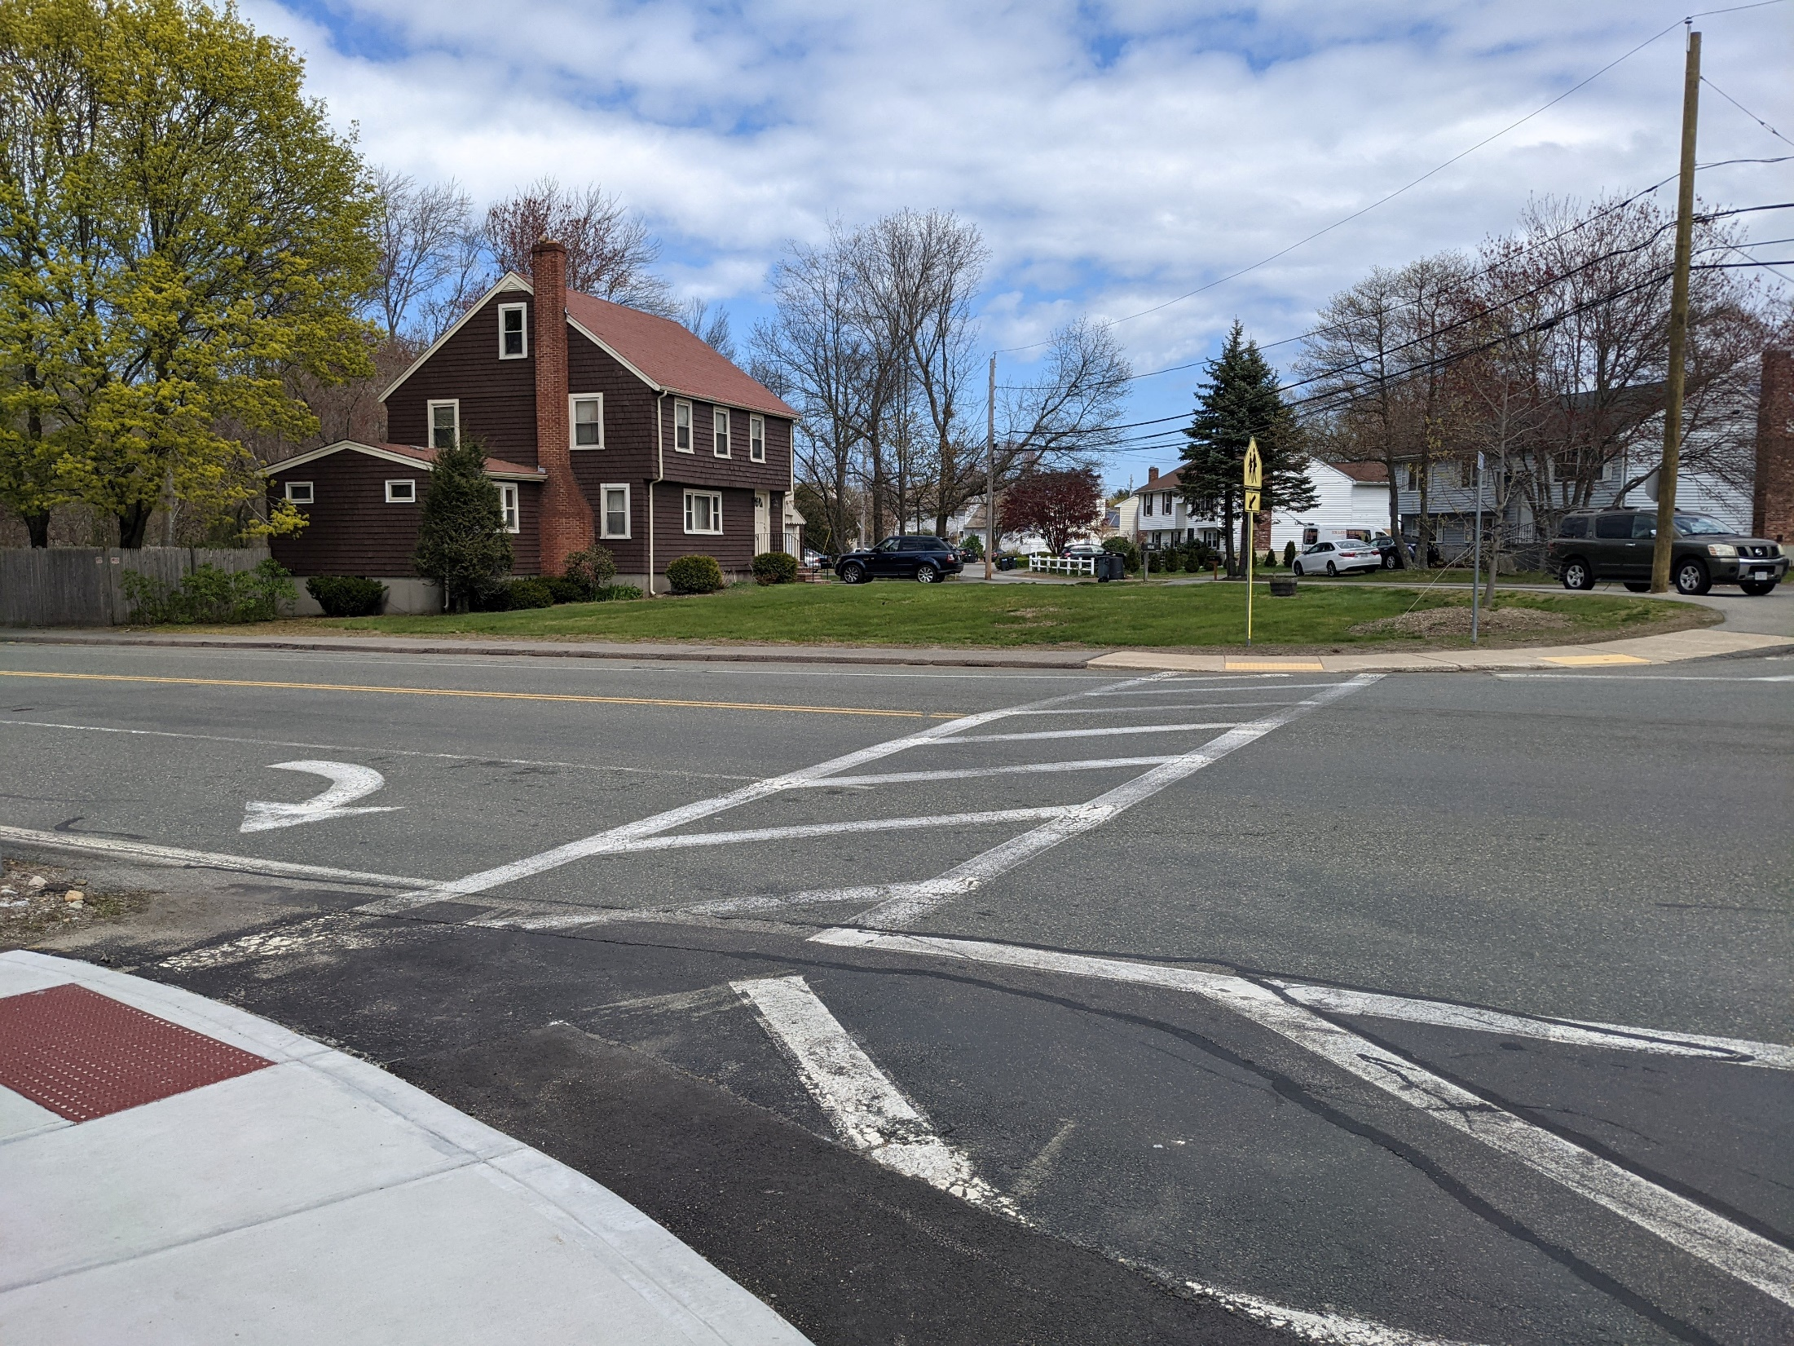

Town of Randolph
Complete Streets Program Prioritization Review
October 17, 2022
2:00 PM
Jeff Maxtutis
Project Manager
Anna Sangree
Transportation Planner

Slide 2
Project Prioritization
Prioritization Factor | Maximum Points Possible
Complete Streets Elements (Safety, ADA Access, Pedestrian Mobility, Bike Mobility, Transit Operations, Vehicle Operations, and Freight Operations) | 14
Walking/Biking Demand (Everyday Walking and Biking Score From MassDOT ) | 7
Environmental Justice Groups | 7
Proximity to Walking and Biking Destinations | 7
Proximity to Transit | 7
Sidewalk Quality / Connectivity | 7
Crash History | 7
 | 70

Slide 3
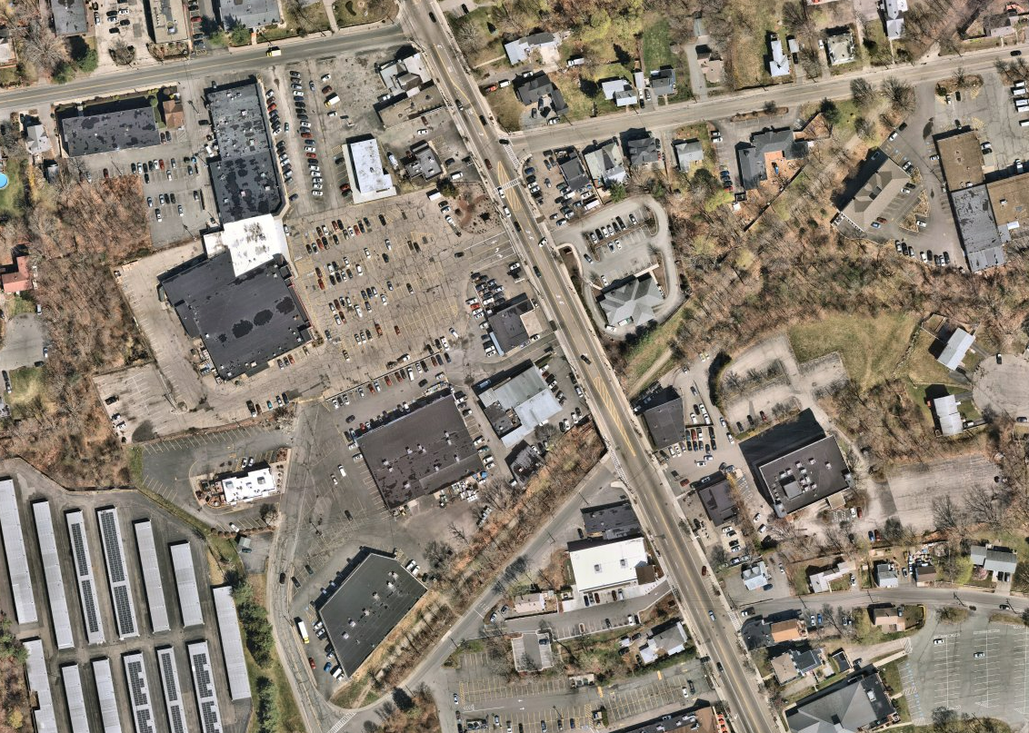
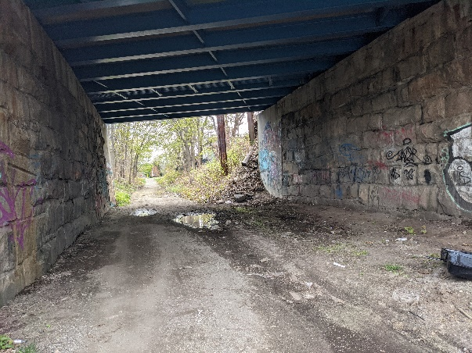
Q: Shared Use Path Improvements
1
Introduce lighting
Improve bike / walking mobility by paving and activating shared use path
Add plantings and landscaping and solar powered lighting
Mural Spot?
Nearmap, 2022

Slide 4
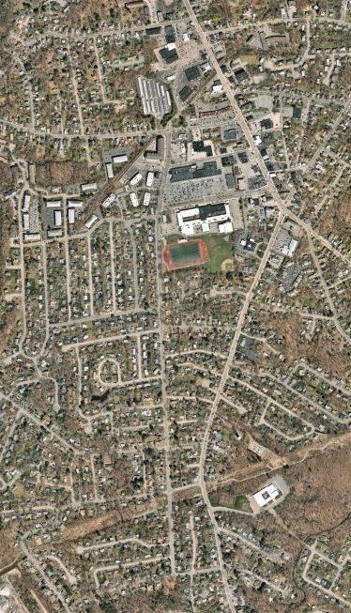
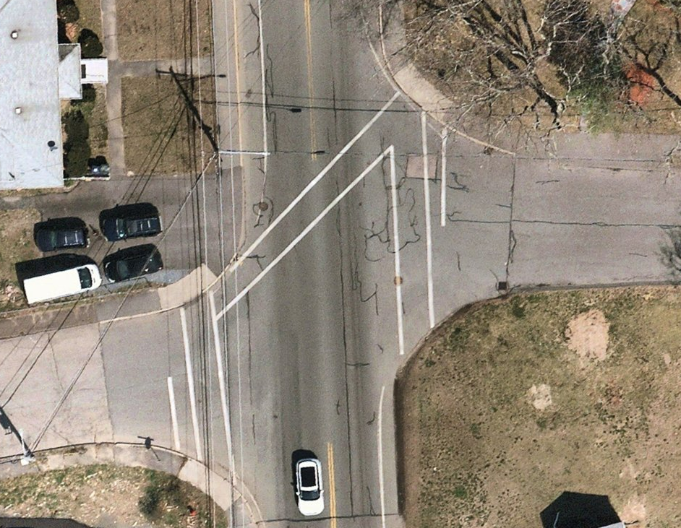
N: Highland Ave Bike Lanes and Woodlawn Crossing Improvements
Improve bike mobility by adding bike lane on both sides
Realign crosswalk
Shorten crossing distance at Woodlawn
Add pedestrian ramps
Add 2 speed feedback signs
2
Nearmap, 2022

Slide 5
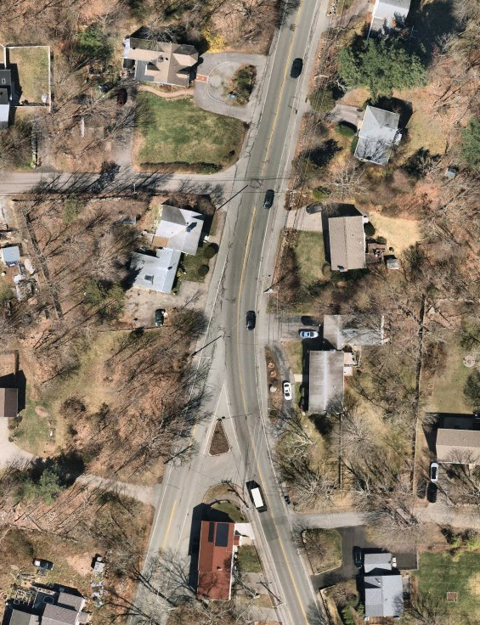
L: Lafayette Street and High Street Intersection Improvements
High Street
Realign as 90-degree T-intersection
Reduce crossing distances across High Street
Add pedestrian ramps
Add new crosswalk across Lafayette Street
Add two speed feedback signs
High Street
Lafayette Street
3
Nearmap, 2022

Slide 6
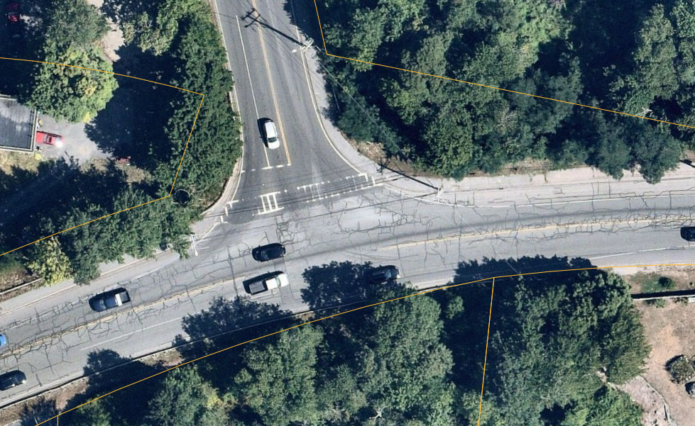
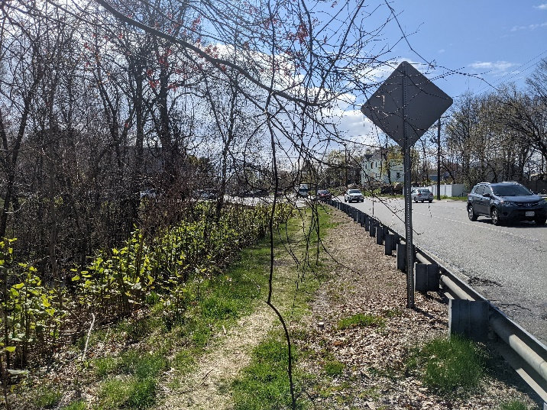
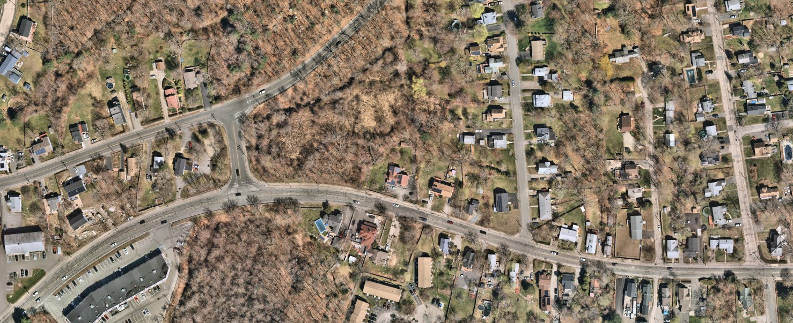
M: West Street Extension and Warren Street Crossing Treatment and South Side Sidewalk
Signalized intersection
West Street Ext.
Warren St
Improve pedestrian and bike mobility
Introduce formalized crossing with new signal and median island
Add pedestrian ramps
4
Nearmap, 2022

Slide 7
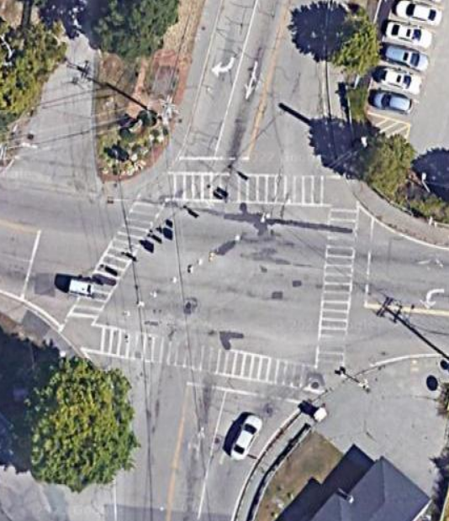
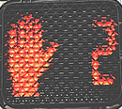
O: Union Street and Center Street Intersection Pedestrian Improvements
Improve accessibility and pedestrian mobility
Add pedestrian countdown and APS signals
Reconstruct ramps and add detectable warning panels
Union Street
Center Street
5

Slide 8
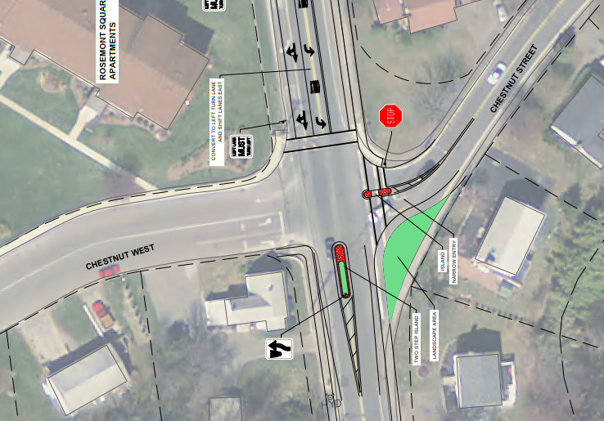
G: Chestnut and High Street Intersection Improvements
Add RRFB
Upgrade pedestrian ramps for ADA compliance
Reduce east side crossing distance from 105 feet to 60 feet
Reduce west side crossing distance from 70 feet to 43 feet
6

Slide 9
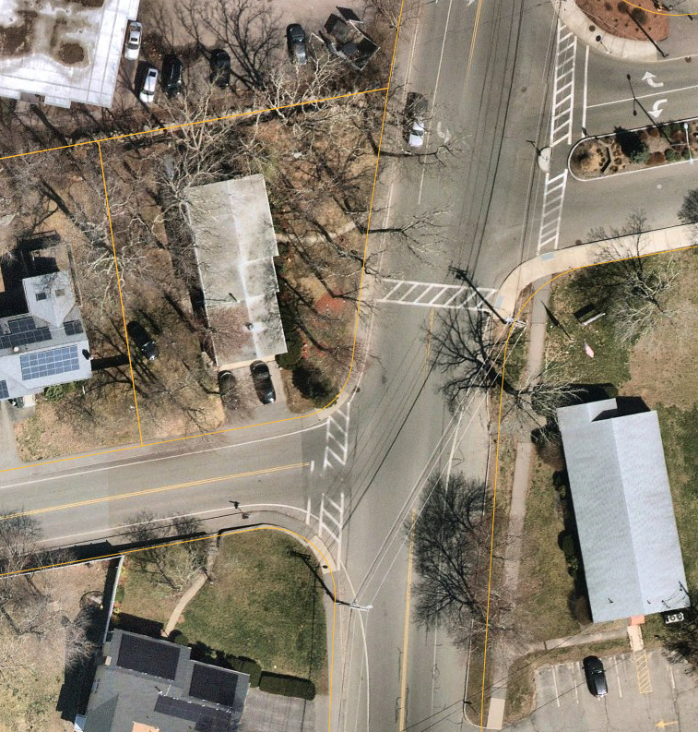
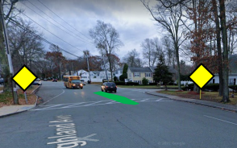
F: Highland Ave and Memorial Parkway Crossing Improvements
RRFB
Memorial Parkway
Add RRFB and median island to pedestrian crossing
Upgrade pedestrian ramps for ADA compliance
Highland Avenue
Nearmap, 2022
7

Slide 10
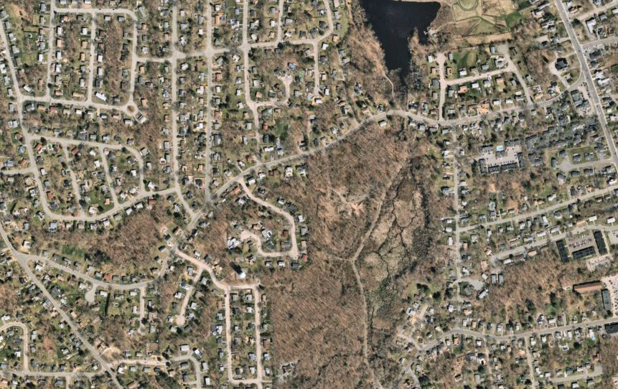
H: Grove Street Sidewalk Reconstruction and ADA Ramp Installation
Route 28
Grove Street
Reconstruct existing north side sidewalk
Upgrade 12 pedestrian ramps for ADA compliance
Add two speed feedback signs
Lafayette Street
Nearmap, 2022
8

Slide 11
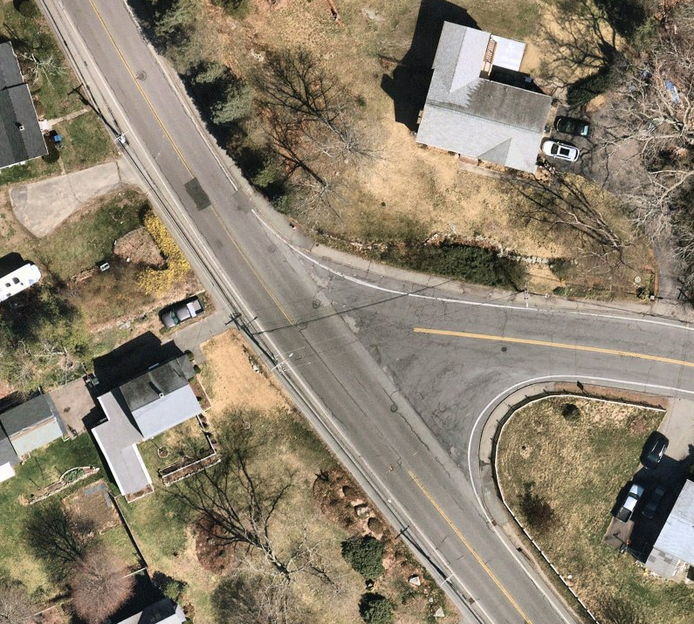
I: Lafayette and Grove Crossing Improvements
Lafayette Street
Add Crosswalk
Improve sight lines for turning vehicles
Bump-out and refuge island reduces longest crossing distance from 118 feet to 68 feet
Add two speed feedback signs
Grove Street
68 Ft
9
Nearmap, 2022

Slide 12
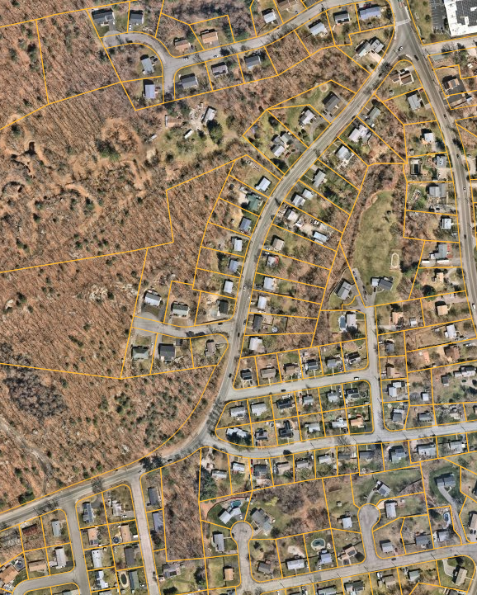
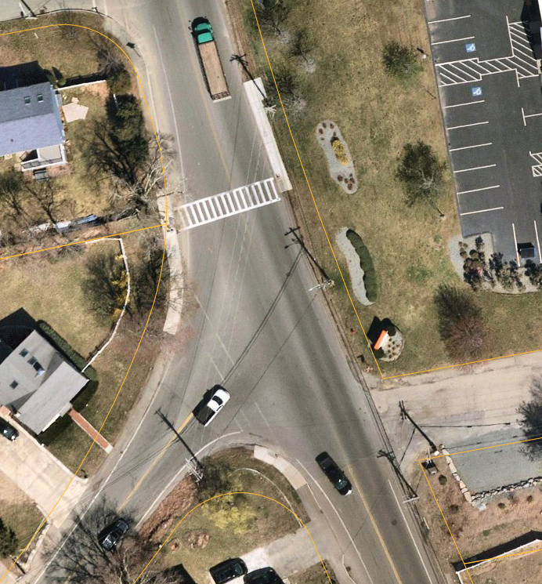
C: Oak Street Sidewalk and Intersection Improvement
Construct/reconstruct 2,100 feet of 5-foot sidewalk on north side of Oak Street
Add two new crosswalks at Devine Road and Paine Road
Add northside curb extension and repaint crosswalk at North Street
Add two speed feedback signs
10

Slide 13
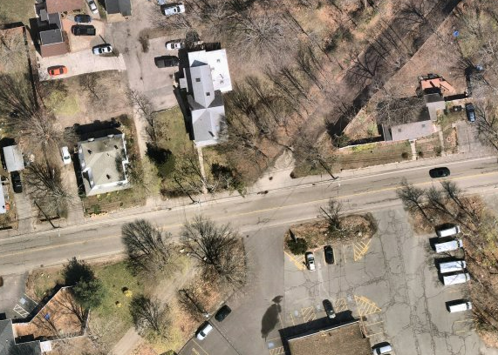
P: Shared Use Trail Crossing at Pleasant Street
Improve visibility of shared use trail crossing by painting crosswalk
Add pedestrian ramps
Crossing signs
Nearmap, 2022
11

Slide 14
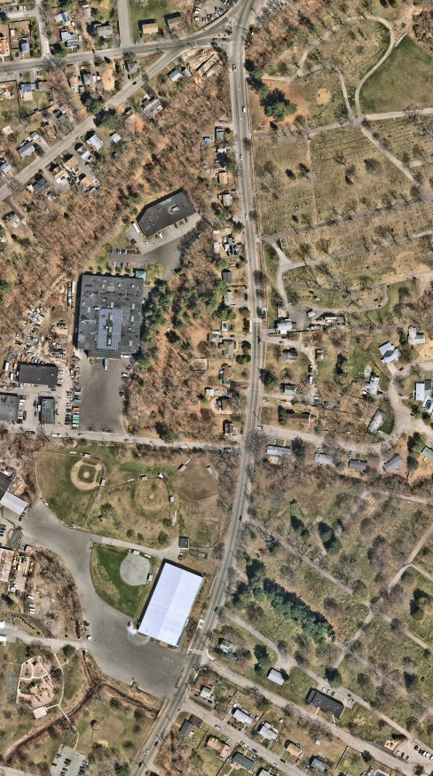
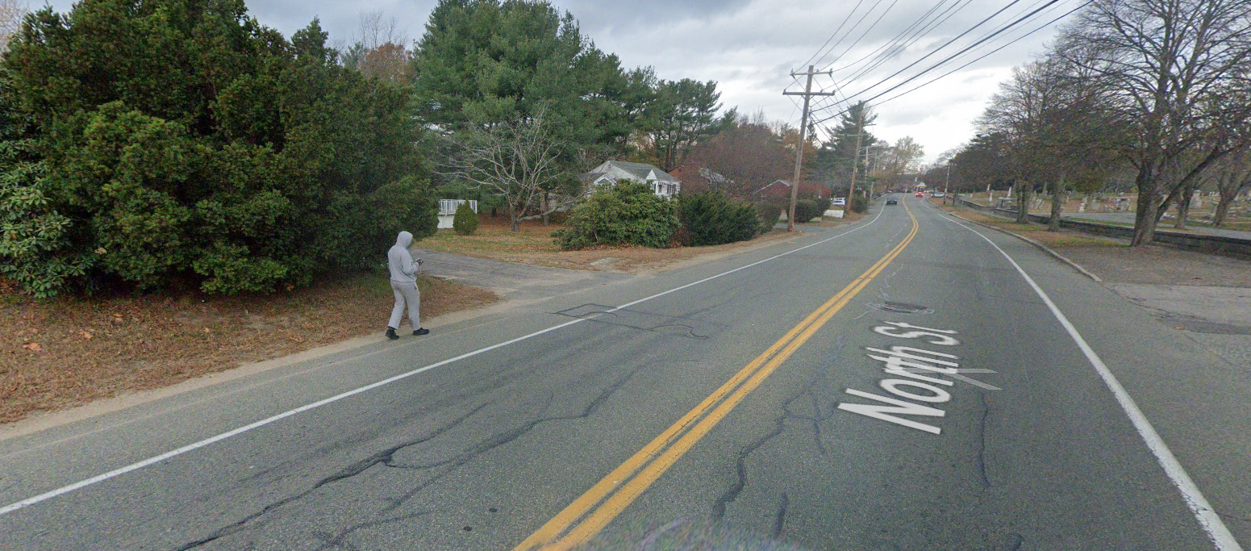
S: North Street Sidewalk
Add sidewalk on west side from 368 North Street to Ice Arena
Improve pedestrian mobility and connectivity
Add two speed feedback radar signs
12
Nearmap, 2022

Slide 15
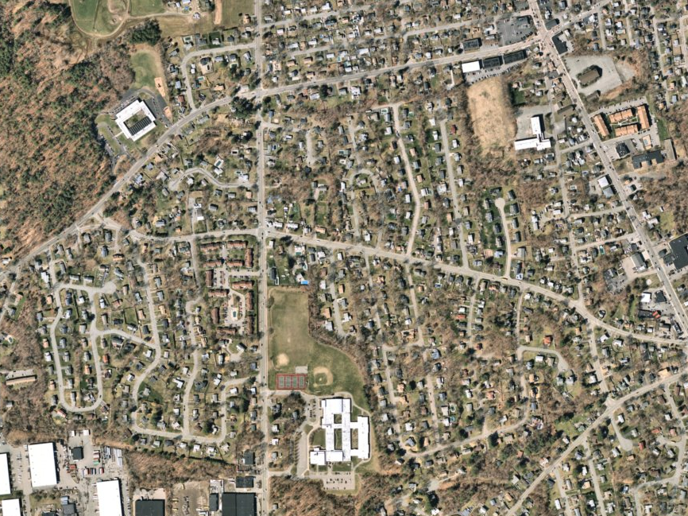
E: High Street by Middle School Sidewalk, Shared Use Path, and Ramp Upgrades
Canton Street
8 foot wide shared use path
5 foot wide sidewalk
Improve mobility for people biking or walking
Add visibility improvements to pedestrian crossing through RRFB
Reconstruct pedestrian ramps and add detectable warning panels to better serve people with disabilities
Add two speed feedback radar signs
RRFB
High Street
13
Nearmap, 2022

Slide 16
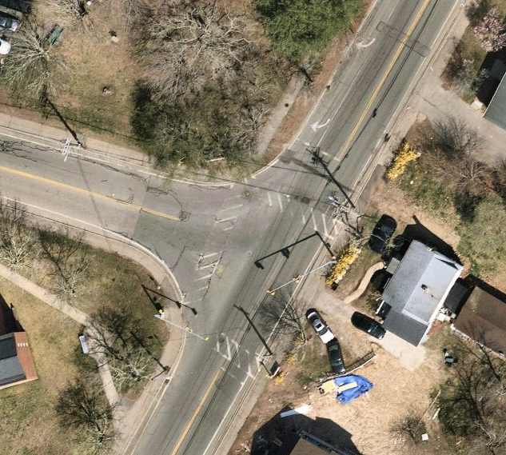
T: North Street and Pleasant Street Intersection Upgrade
Add pedestrian countdown and APS
Improve pedestrian mobility
Improve accessibility for people with disabilities at RHA by reconstructing ramps and adding detectable warning panels
North Street
Pleasant Street
14
Nearmap, 2022

Slide 17
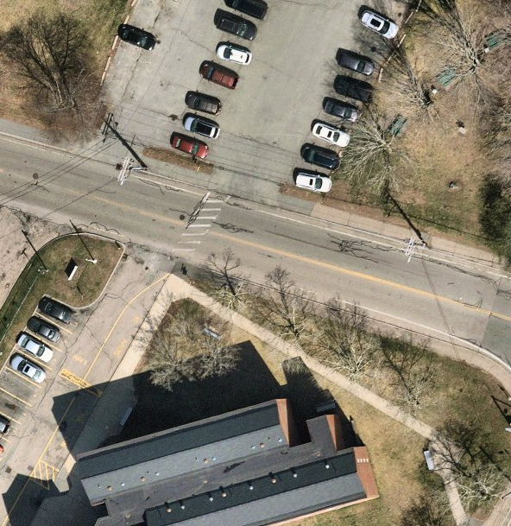
R: Pleasant Street and Decelle Drive Crossing Upgrade
RRFB
Move crosswalk out of driveway
Improve visibility of crosswalk at RHA by adding RRFB
15
Nearmap, 2022

Slide 18
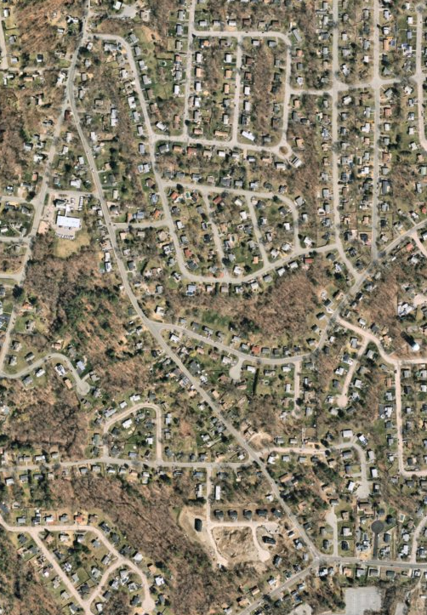
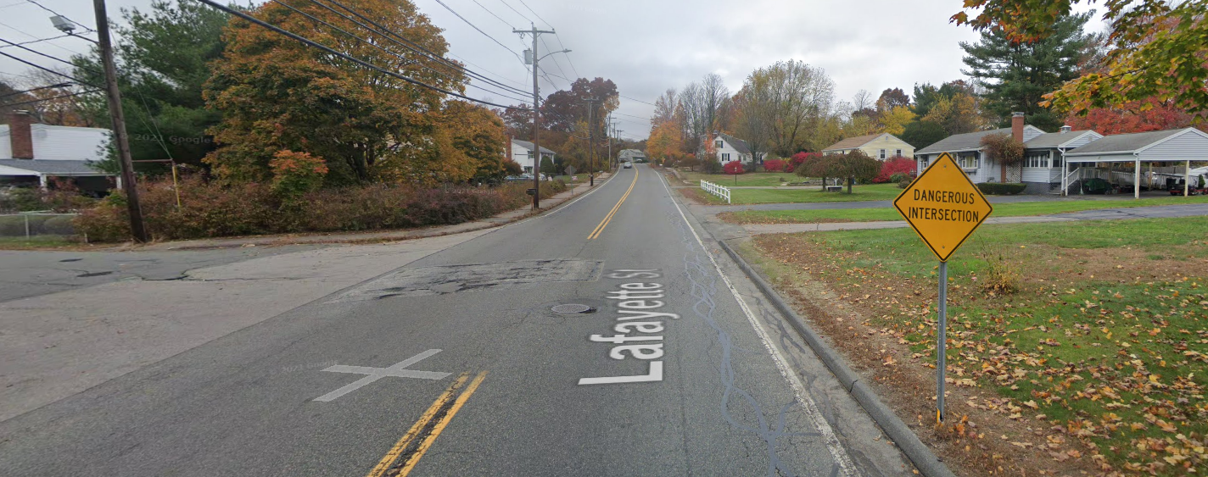
J: Lafayette Street East Side Sidewalk From Grove to High
16
Improve Pedestrian Mobility and Accessibility for people with disabilities
Construct a 4’-5’ sidewalk on east side to fill current gap
Pedestrian ramps at Vine Street
Trim Vegetation
Vine Street
Lafayette Street
Nearmap, 2022

Slide 19
D: Old Street / Canton Street Bike Lanes (from Reed Street to Chestnut Street)
17
Reed Street
Canton Street
Improve mobility for people biking by adding 5-foot bike lanes with a 2 foot buffer (where space permits) on both sides of road.
Reduce lane width from 14-15 feet to 10-11 feet to lower speeds
Existing roadway is between 30 feet and 36 feet wide with 14-15 foot travel lanes
Add two speed feedback signs
High Street
Old Street
Nearmap, 2022

Slide 20
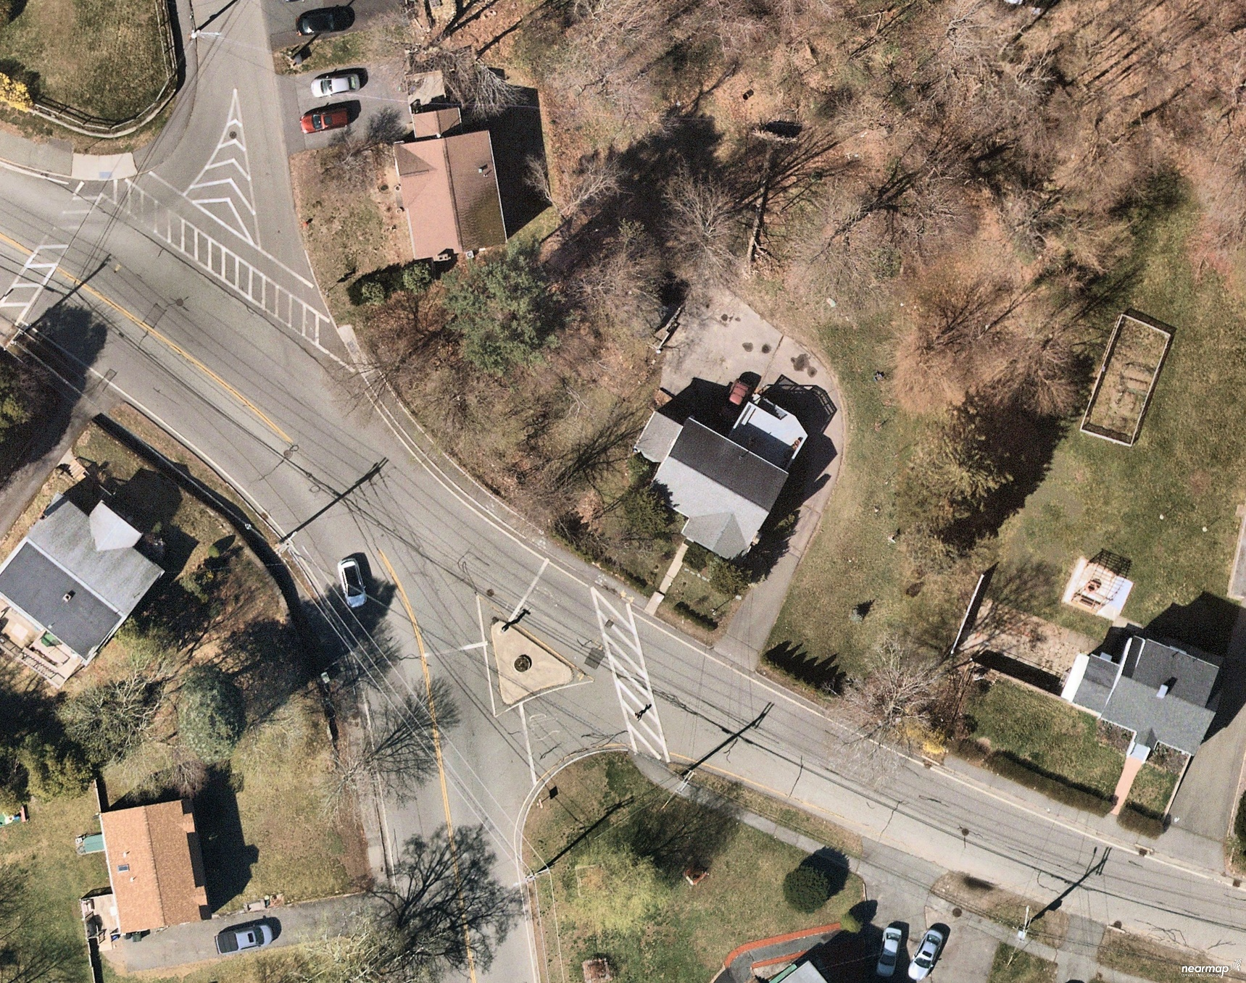

A: Canton Street and Old Street Intersection Realignment
Old Street
STOP
33 ft
Canton Street
38 ft
Improve sight lines for turning vehicles
Reduces longest crossing distance from 86 feet to 33 feet
slow speeds near future school site
Add two speed feedback signs
STOP
20 ft
Canton Street
Nearmap, 2022
18
Old Street
Old Street

Slide 21
K: Lafayette Street East Side Sidewalk From High Street to West Street
Install 4–5-foot sidewalk for 1,650 feet on east side
Add pedestrian ramps at Lisa Rd
Improves mobility for people walking in the area
Constraints: stone walls, mail boxes, utility poles
Add two speed feedback signs
19
Nearmap, 2022

Slide 22
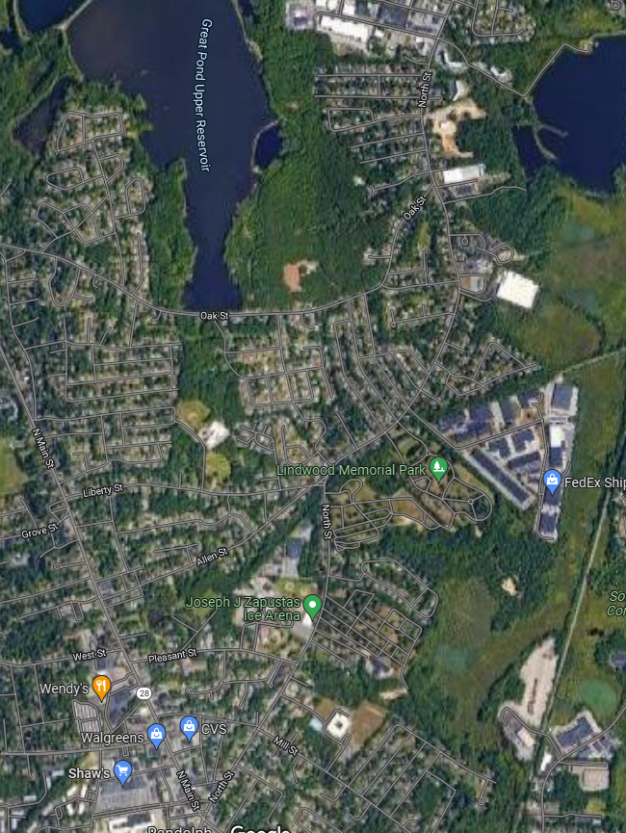
X: North Street Bike Lanes
Reduces travel lane width
Improves bicycle connectivity for 2.2 mile stretch
Add two speed feedback signs
Add buffer at wide roadway sections
20

Slide 23
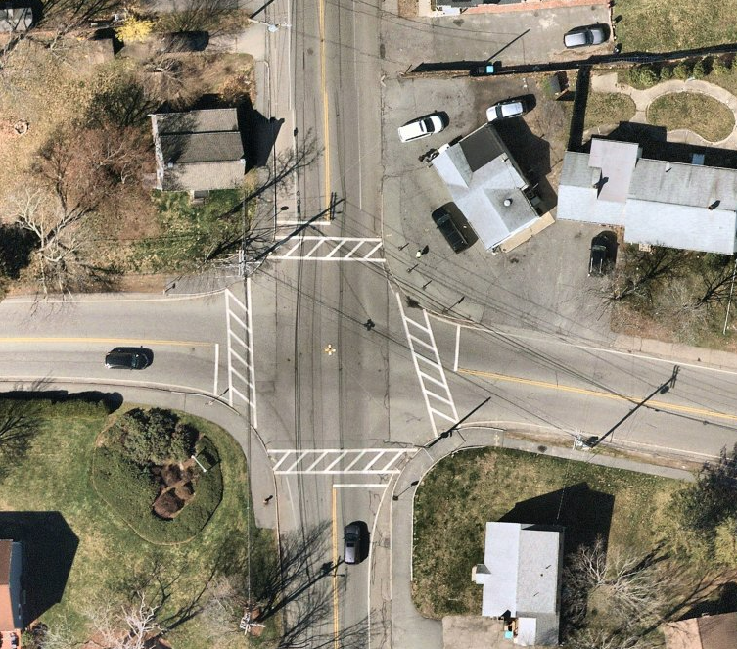
B: Canton Street and High Street ADA Improvements
Nearmap, 2022
High Street
ALL WAY
STOP
STOP
ALL WAY
Add flashing stop signs. Improve accessibility through new ramps and detectable warning panels and level sidewalk
New delineator curb between parking area and sidewalk
Improve driver awareness with all way stop plaques
Canton Street
ALL WAY
STOP
STOP
ALL WAY
21

Slide 24
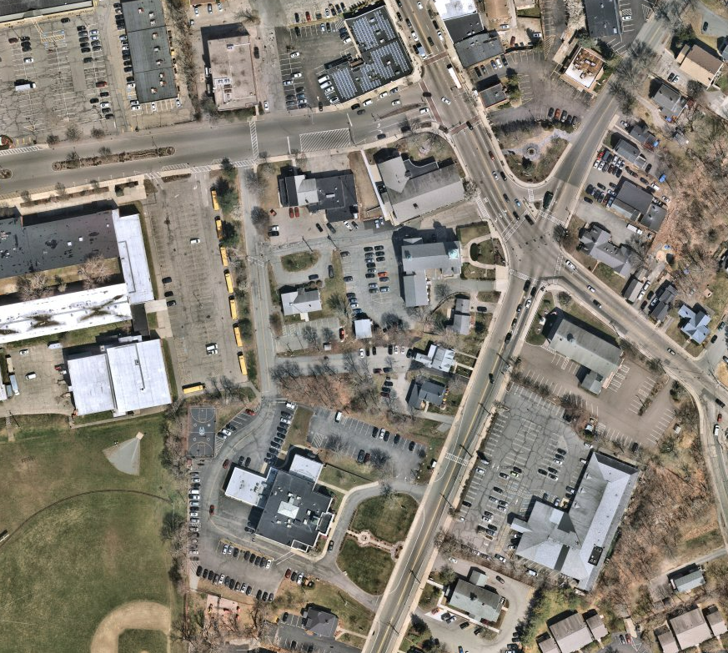
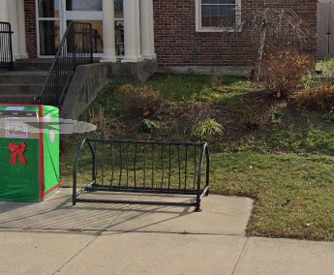
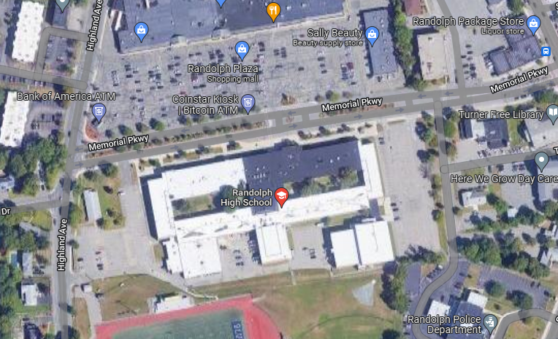
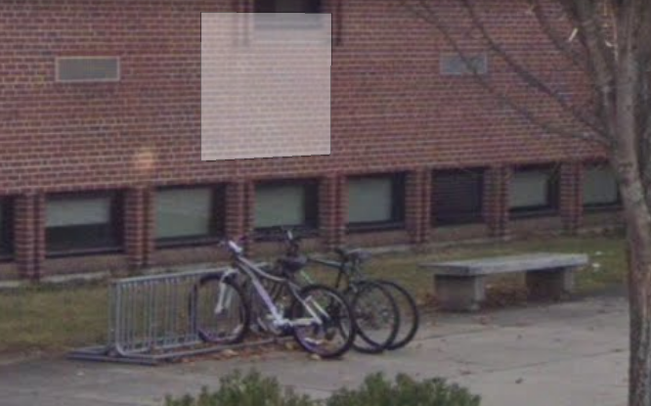
V: Bicycle Racks
22
Existing Rack is not conducive to locking bikes
Town Hall, Library, High School
Improve bicycle mobility
Existing racks are well used, but don’t allow locking
Nearmap, 2022

Slide 25
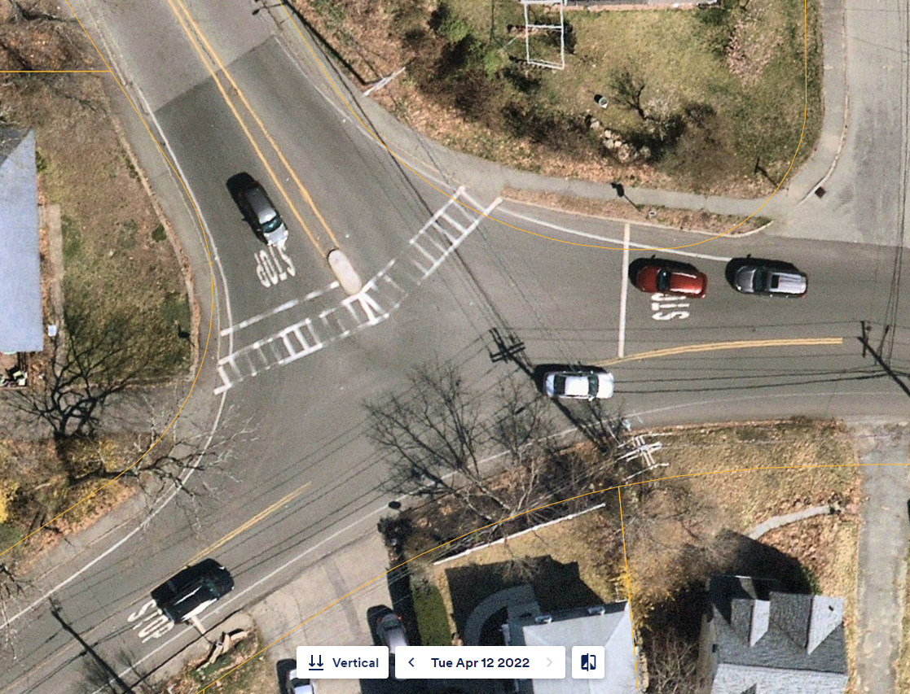
W: West Street and Lafayette Intersection Improvement
Lafayette Street
Improve Pedestrian Mobility and Accessibility for people with disabilities
Signalize Intersection
Reduce turning radii
Shorten crossing distance
Concurrent Ped Signal
West Street
23

Slide 26
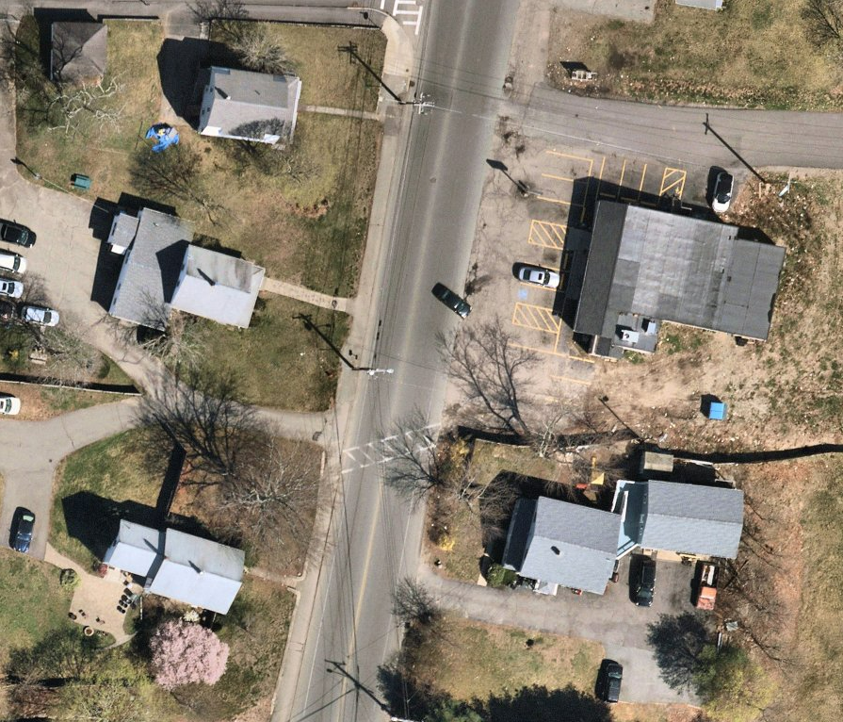
U: North Street and Colonial Liquors Intersection Improvement
North Street
RRFB
Realign crosswalk
Improve pedestrian mobility and visibility by adding RRFB
Improve accessibility for people with disabilities by adding ramps and adding detectable warning panels
24
Nearmap, 2022

